Slide 1

GOVERNMENT OF KARNATAKA DEPARTMENT OF TECHNICAL EDUCATION GOVERNMENT ENGINEERING COLLEGE HAVERI-581110 DEPARTMENT OF ELECTRONICS & COMMUNICATION ENGINEERING Main Project Presentation on “AI-ENABLED SMART AGRICULTURE SYSTEM” Presented by ANNADANESHWAR C 2GO19EC002 BHARATH KUMAR K 2GO19EC006 HEMANTH U 2GO19EC007 ROHIT B A 2GO19EC025 Under the guidance of Prof. SUMANGALA G S M Tech Assistant Professor

Slide 2
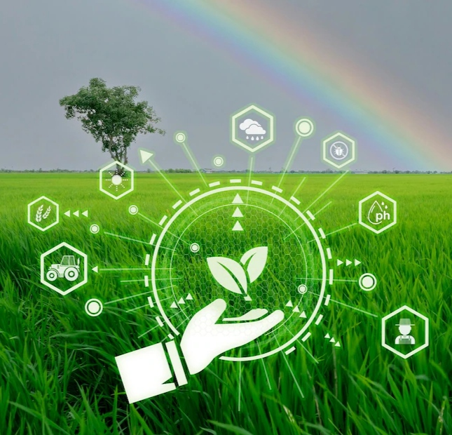
CONTENTS
PROBLEM STATEMENT
INTRODUCTION
OBJECTIVES
LITERATURE REVIEW
COMPONENTS REQUIRED
METHODOLOGY
RESULTS AND DISCUSSION
APPLICATION
ADVANTAGES AND DISADVANTAGES
CONCLUSION
FUTURE SCOPE

Slide 3
01
PROBLEM STATEMENT
Agriculture is a significant contributor to the country's economy and modernization can reduce dependency on individual labor. In the traditional farming method, farmers are facing the problems like,
Crop damage caused by animals is one of the major threats in reducing crop yield. This leads to huge losses for farmers.
Diseases can damage crops in all stages of development and affect crop yield.
Loss of moisture in the soil leads to less yield.

Slide 4
02
INTRODUCTION
Agriculture is the art of cultivating crops to meet the basic requirement of food for every living being.
Smart agriculture uses digital techniques to optimize agricultural production processes and offer solutions that can be applied to all farmers.
Artificial Intelligence (AI) in agriculture has revolutionized crop production and protected crop yield from various factors.
Deep learning makes agricultural applications incredibly efficient and can be used for animal detection and disease identification in plants.
Internet of Things (IOT) enables controlled and productive crop growth through enhanced monitoring.

Slide 5
03
OBJECTIVES
The main objectives are:
Deploying animal detection system with night vision camera using deep learning algorithm DNN.
Deploying leaf disease detection system with the camera using deep learning algorithm CNN.
Gathering soil moisture information from sensor and sending it to the user application.

Slide 6
04
LITERATURE REVIEW
SL NO | Authors | Title | Board & Sensors | Technology | Draw backs
01 | Prashanth P, Bindu D, Dilip Kumar M D, Mamatha B. | Prevention Of Wild Animals Entering Into The Agricultural Field | Raspberry pi, GSM Module/Modem. | Real-Time Image Processing | Concentrated only on elephants, Minimize Manual work.
02 | Pranesh Kulkarni, Atharva Karwande, Tejas Kolhe, Soham Kamble, Akshay Joshi, Medha Wyawahare. | Plant Disease Detection Using Image Processing And Machine Learning |  | Artificial Intelligence(ML), Image Processing. | Selected only 25 classes, Concentrated only on 5 plants.

Slide 7
05
LITERATURE REVIEW
03 | Muhammad Junaid, Asadullah Shaikh, Mahmood Ul Hassan, Abdullah Alghamdi, Khairan Rajab. | Smart Agriculture Cloud Using Ai-based Techniques |  | Artificial intelligence, Cloud computing | Implemented with only Pakistan climate factors considered due to the huge cost involved
04 | Dr. N. Rajeshkumar, B. VaishnaV I, K. Saranya, C. Surabhi | Smart Crop-field Monitoring And Automation Irrigation System Using Iot | Raspberry pi, Moisture sensor. | Internet of things (IoT) | Minimize the manual work.

Slide 8
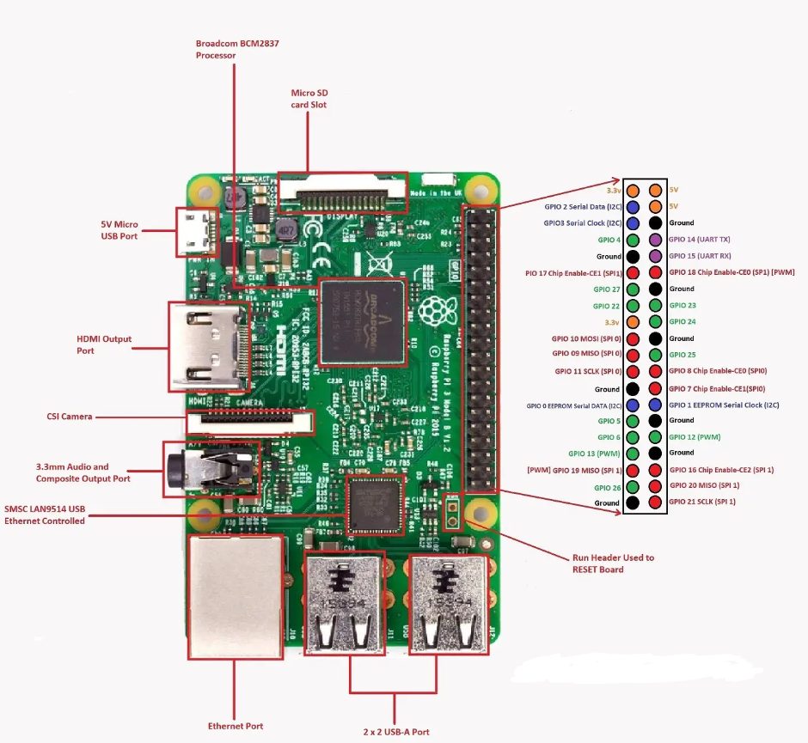
COMPONENTS REQUIRED
06
RASPBERRY PI 3 MODEL B:

Slide 9
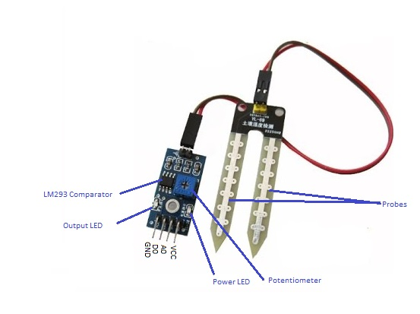
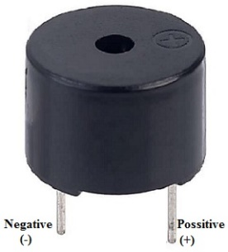
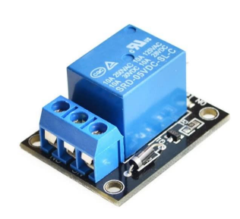
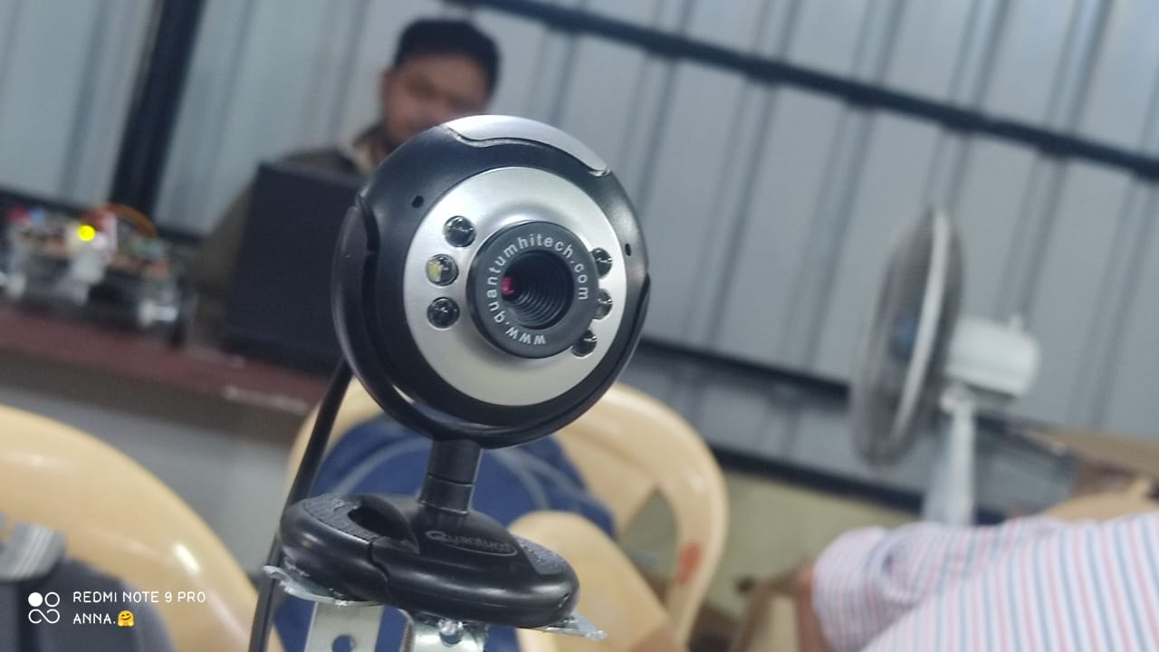
07
COMPONENTS REQUIRED
MOISTURE SENSOR:
BUZZER:
RELAY:
CAMERA:

Slide 10



08
SOFTWARES REQUIRED
Raspberry pi OS
Python
Open CV
Telegram
OS: Windows
Raspberry pi user interface

Slide 11
METHODOLOGY
09
BLOCK DIAGRAM:
Camera
Raspberry Pi
Moisture sensor
Buzzer
Motor
Machine learning algorithm
IOT
IOT Communicator
System With Web app

Slide 12
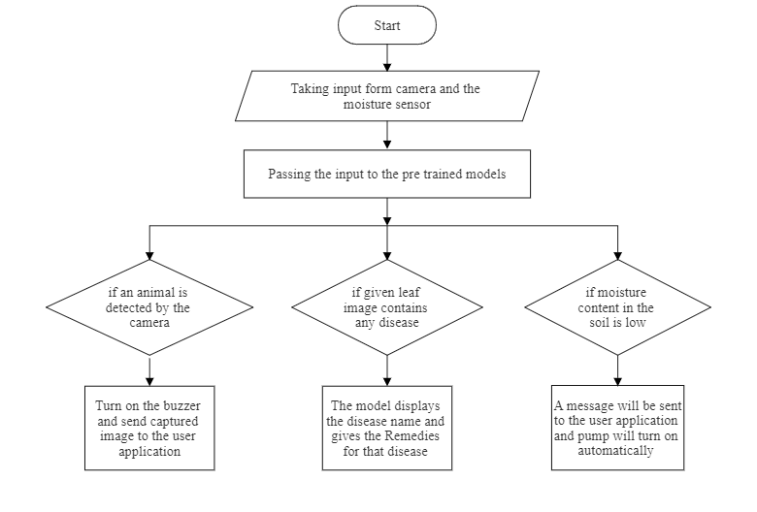
METHODOLOGY
10
FLOW CHART:

Slide 13
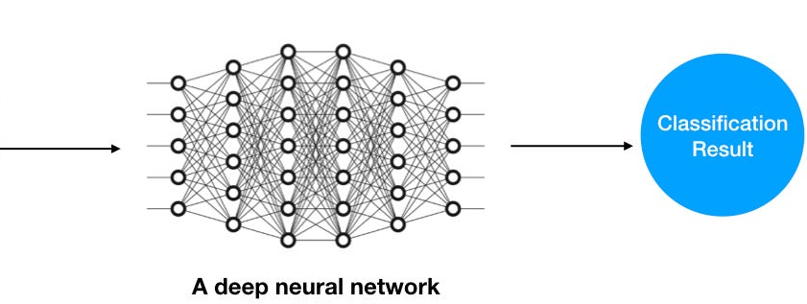
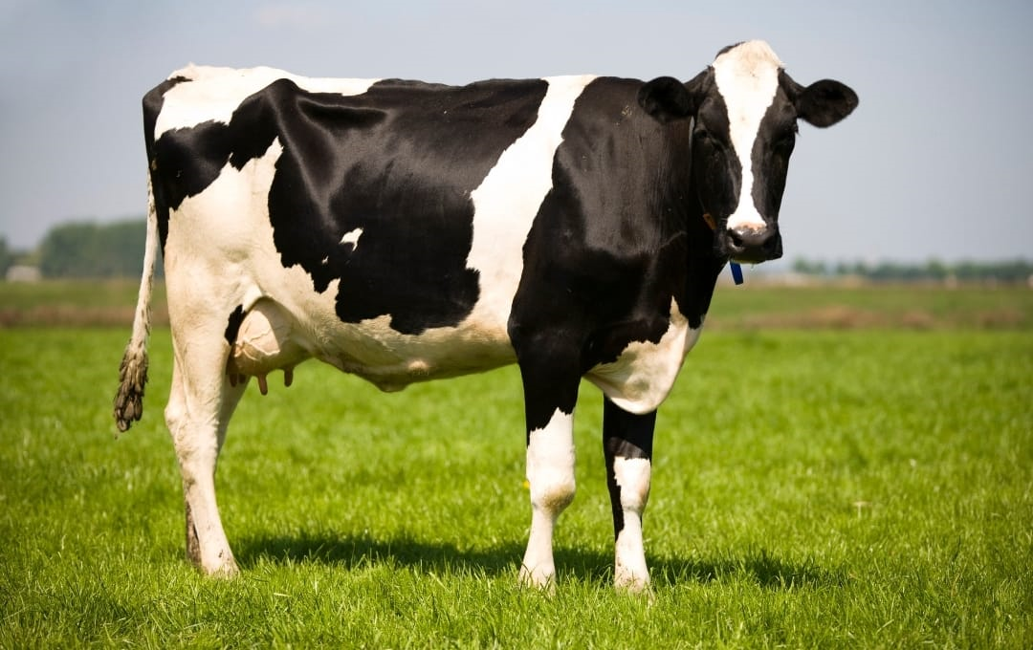
METHODOLOGY
11
Fig: Animal detection using DNN

Slide 14
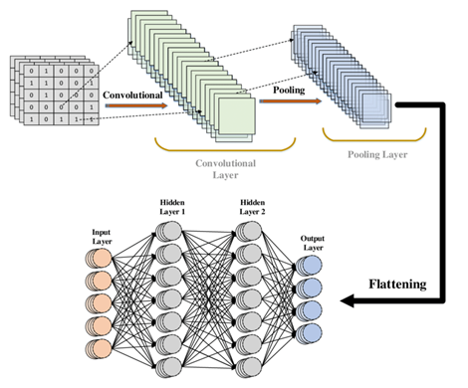
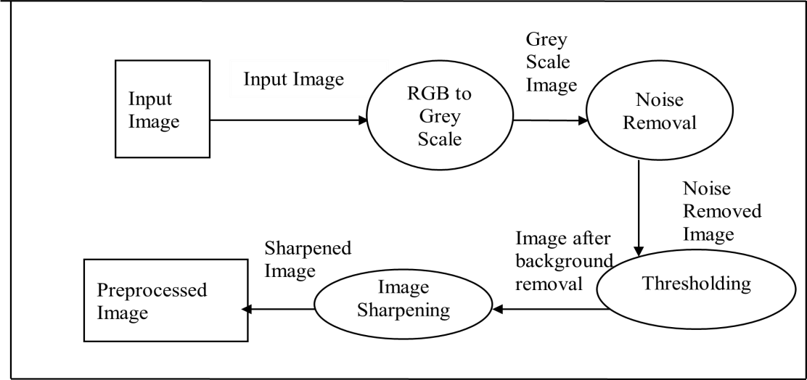
METHODOLOGY
12
Fig: Data Flow Diagram for the pre-processing module.
Fig : CNN Process

Slide 15
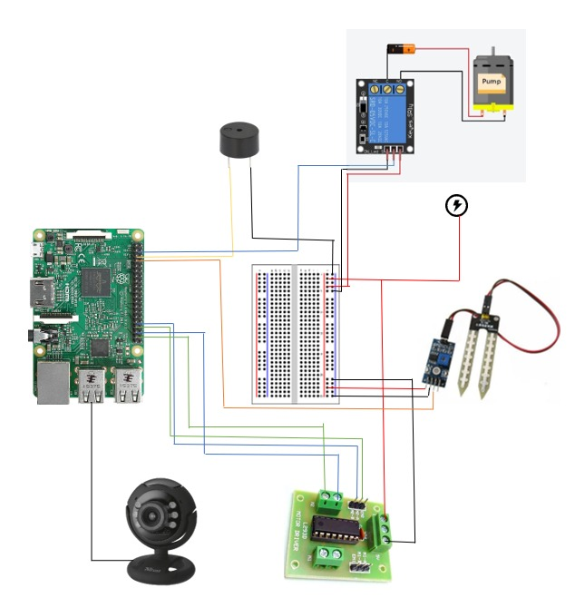
METHODOLOGY
13
CIRCUIT DIAGRAM:

Slide 16
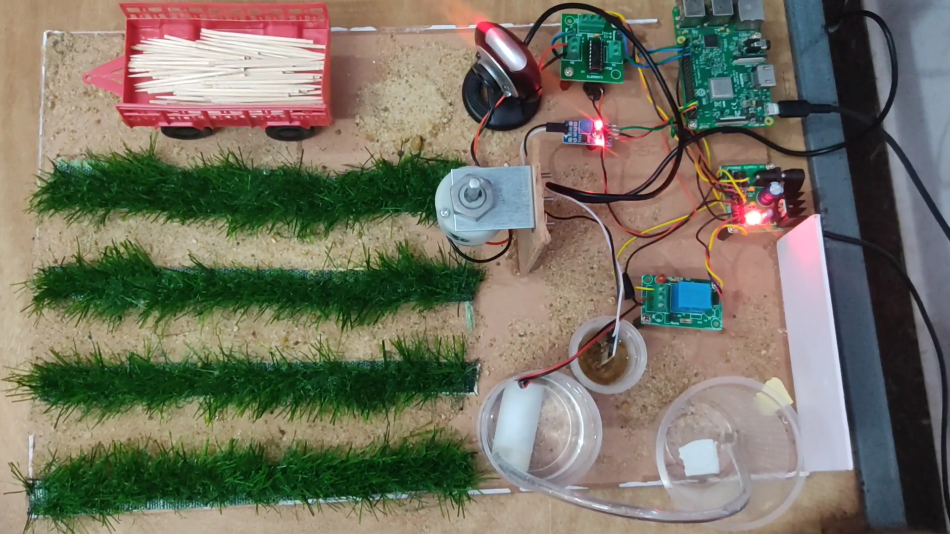
RESULTS AND DISCUSSION
14
OUR MODEL:

Slide 17
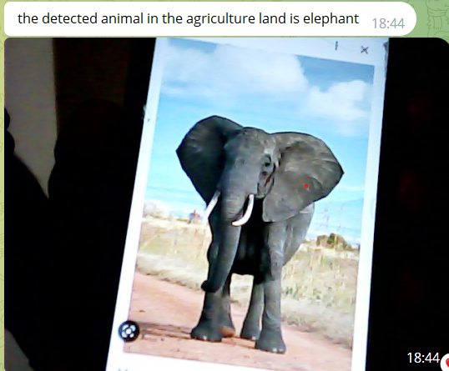
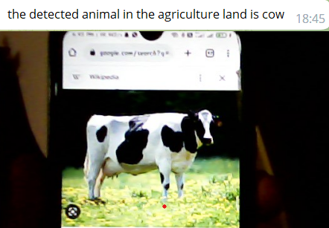
RESULTS AND DISCUSSION
15
ANIMAL DETECTION PAGE:
Fig 2: Images captured by the cam are sent to the user

Slide 18
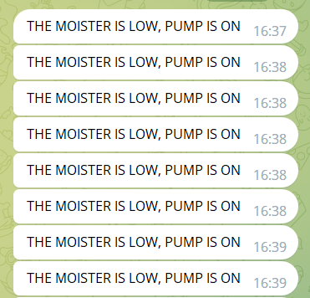
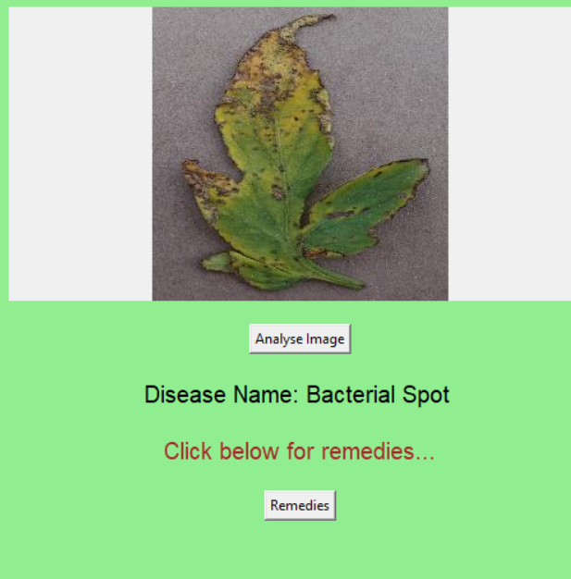
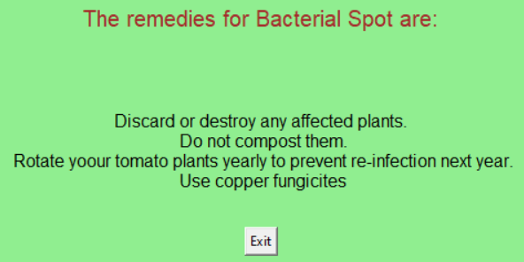
RESULTS AND DISCUSSION
16
Fig 3: Message sent to the user about moisture content
(A) Disease Detected in leaf (B) Remedies for disease

Slide 19
APPLICATIONS
17
AI-based smart agriculture systems can be implemented in large agricultural fields.
AI-based smart agriculture system helps in Solar powered irrigation.
AI-based smart agriculture systems make Home Gardens Portable.
AI-based smart agriculture system helpful to agricultural lands in rural areas.
AI-based smart agriculture system helps in Forests development.

Slide 20
ADVANTAGES
18
It helps to increase productivity.
It saves water and formers time.
Compact and low cost.
It operates the water pump automatically.
It avoids middlemen interference.
No need for human interaction in the field.

Slide 21
DISADVANTAGES
19
Advancement of project leads to Exploitation of workers.
The model requires continuous Power Supply to function properly
Internet interruption can delay information delivery to users.

Slide 22

CONCLUSION
20
The project contains three system which are animal detection system, moisture content detection system, and leaf disease detection system.
In which two system are AI enabled system which are animal detection system using deep neural network (DNN) and leaf disease detection system using convolution neural network (CNN).
Due to insufficiency of time these systems are trained with limited dataset but also got better results with the given datasets.

Slide 23
21
FUTURE SCOPE
Replacing the camera for better image capturing
Can be trained with more data sets to detect all animals.
The sensors can also be replaced with advanced sensors.
Disease detection can be implemented in the robot to protect crops in real-time and the process can be automated.
The system can use machine learning to analyze past data on crop yield.

Slide 24
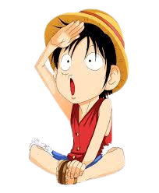
THANK YOU

